Slide 1
计算思维与系统设计
第二讲
从逻辑符号到算数系统
Ben Koo
benkoo@Tsinghua.edu.cn
2月25日，2020
Notes:
今天的主题是“区块链启发的新产业范式”

Slide 2
第一周回顾: Test Driven Design 基于测试的芯片设计
内容:
系统的正确性，根据设计合约的测试方案决定 Test Driven Design
真值表、逻辑电路、HDL等多个语言可以等价地表达一个样的逻辑函数
多种语言之间的转译：Curry-Howard-Lambek Isomorphism
复杂性来自简单元件的链接关系 Complexity comes from composing simple things
NAND/NOR等六个2输入1数据的元件，可以当作“万用元件”，Universal Components
You should be watching Nand2Tetris and Computational Structure’s first week video
Learn the whole stack by building a Blockchain-recorded Go game

Slide 3
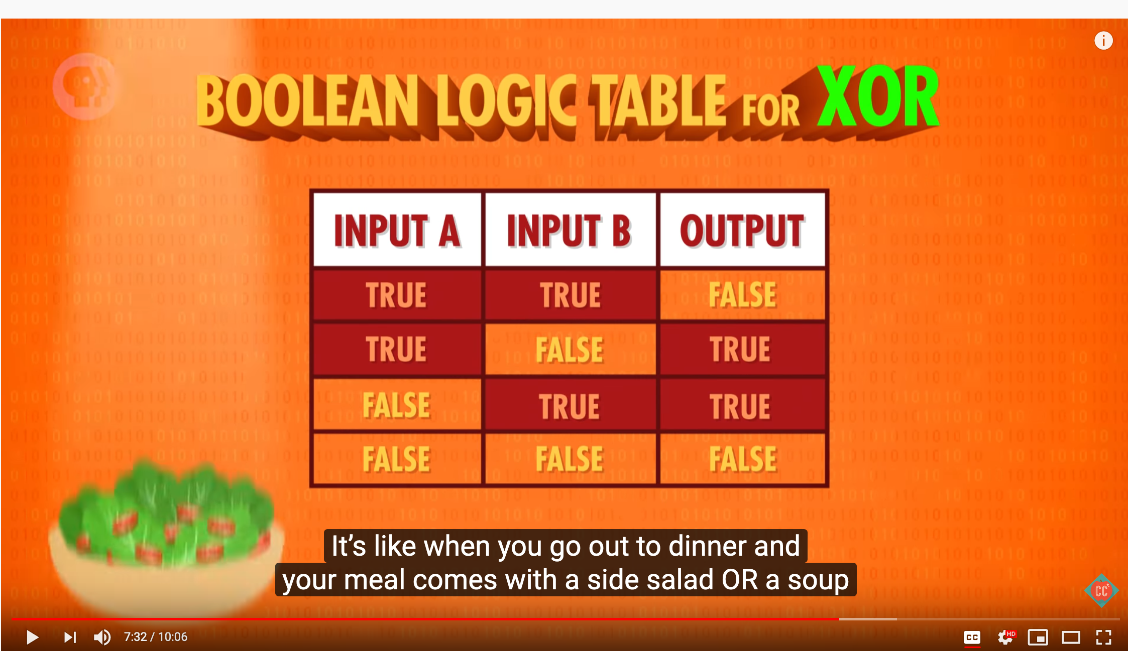
参考文献:
视频:
Coursera Video website: https://www.coursera.org/learn/build-a-computer
Computer Science by PBS: https://youtu.be/gI-qXk7XojA
Boolean Logic & Logic Gates: Crash Course Computer Science #3

Slide 4
01
课程背景
01

Slide 5
一个形式化语言实现一种计算模型
The era of Super-Human Intelligence
The classification of intelligence is determined by the use of Languages
Formal Languages has computable objects: Vocabulary, Grammar, Semantics
From Logics to Number Systems: The Workhorse of Turing Complete Computation: Arithmetic Logic Unit
Memory: The Space-Time Entanglement of Digital Circuitry
Composition: The idea behind the assembly language
From Binary Notation to Human Mnemonics

Slide 6
现代计算系统是多层形式化语言的迭代结构
Human
Abstract design
Software
Thought
abstract interface
hierarchy
Chapters 9, 12
H.L. Language
Compiler
&
abstract interface
Operating Sys.
Chapters 10 - 11
Virtual
VM Translator
Machine
abstract interface
Chapters 7 - 8
Assembly
Language
Assembler
Chapter 6
abstract interface
Computer
Machine
Architecture
Language
abstract interface
Chapters 4 - 5
Gate Logic
Hardware
abstract interface
Platform
Chapters 1 - 3
Electrical
Hardware
Chips &
Engineering
Logic Gates
Physics
hierarchy
(Abstraction–implementation paradigm)

Slide 7
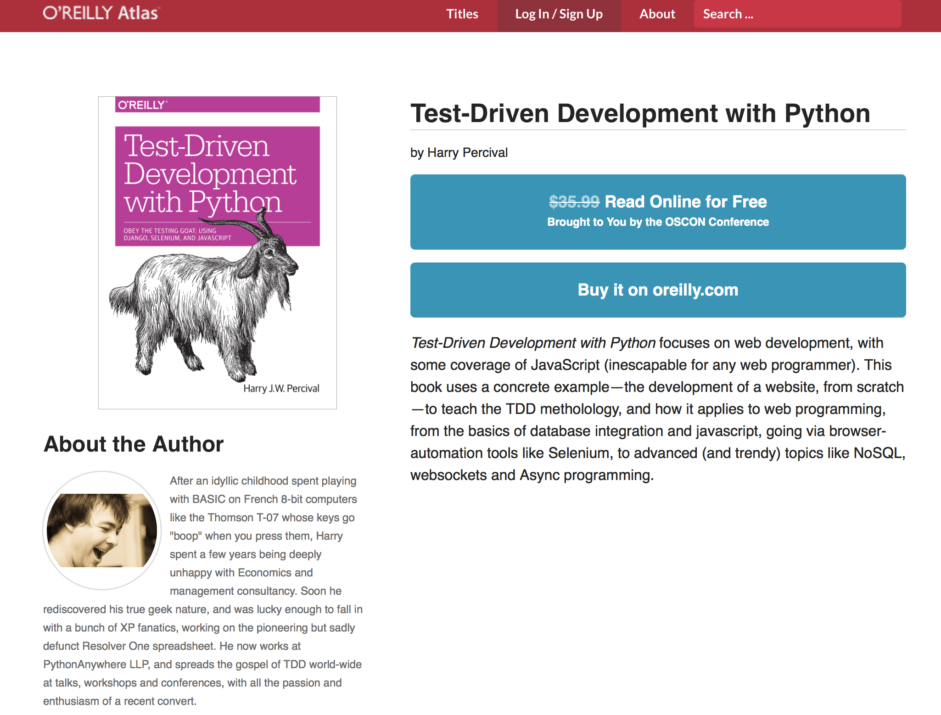
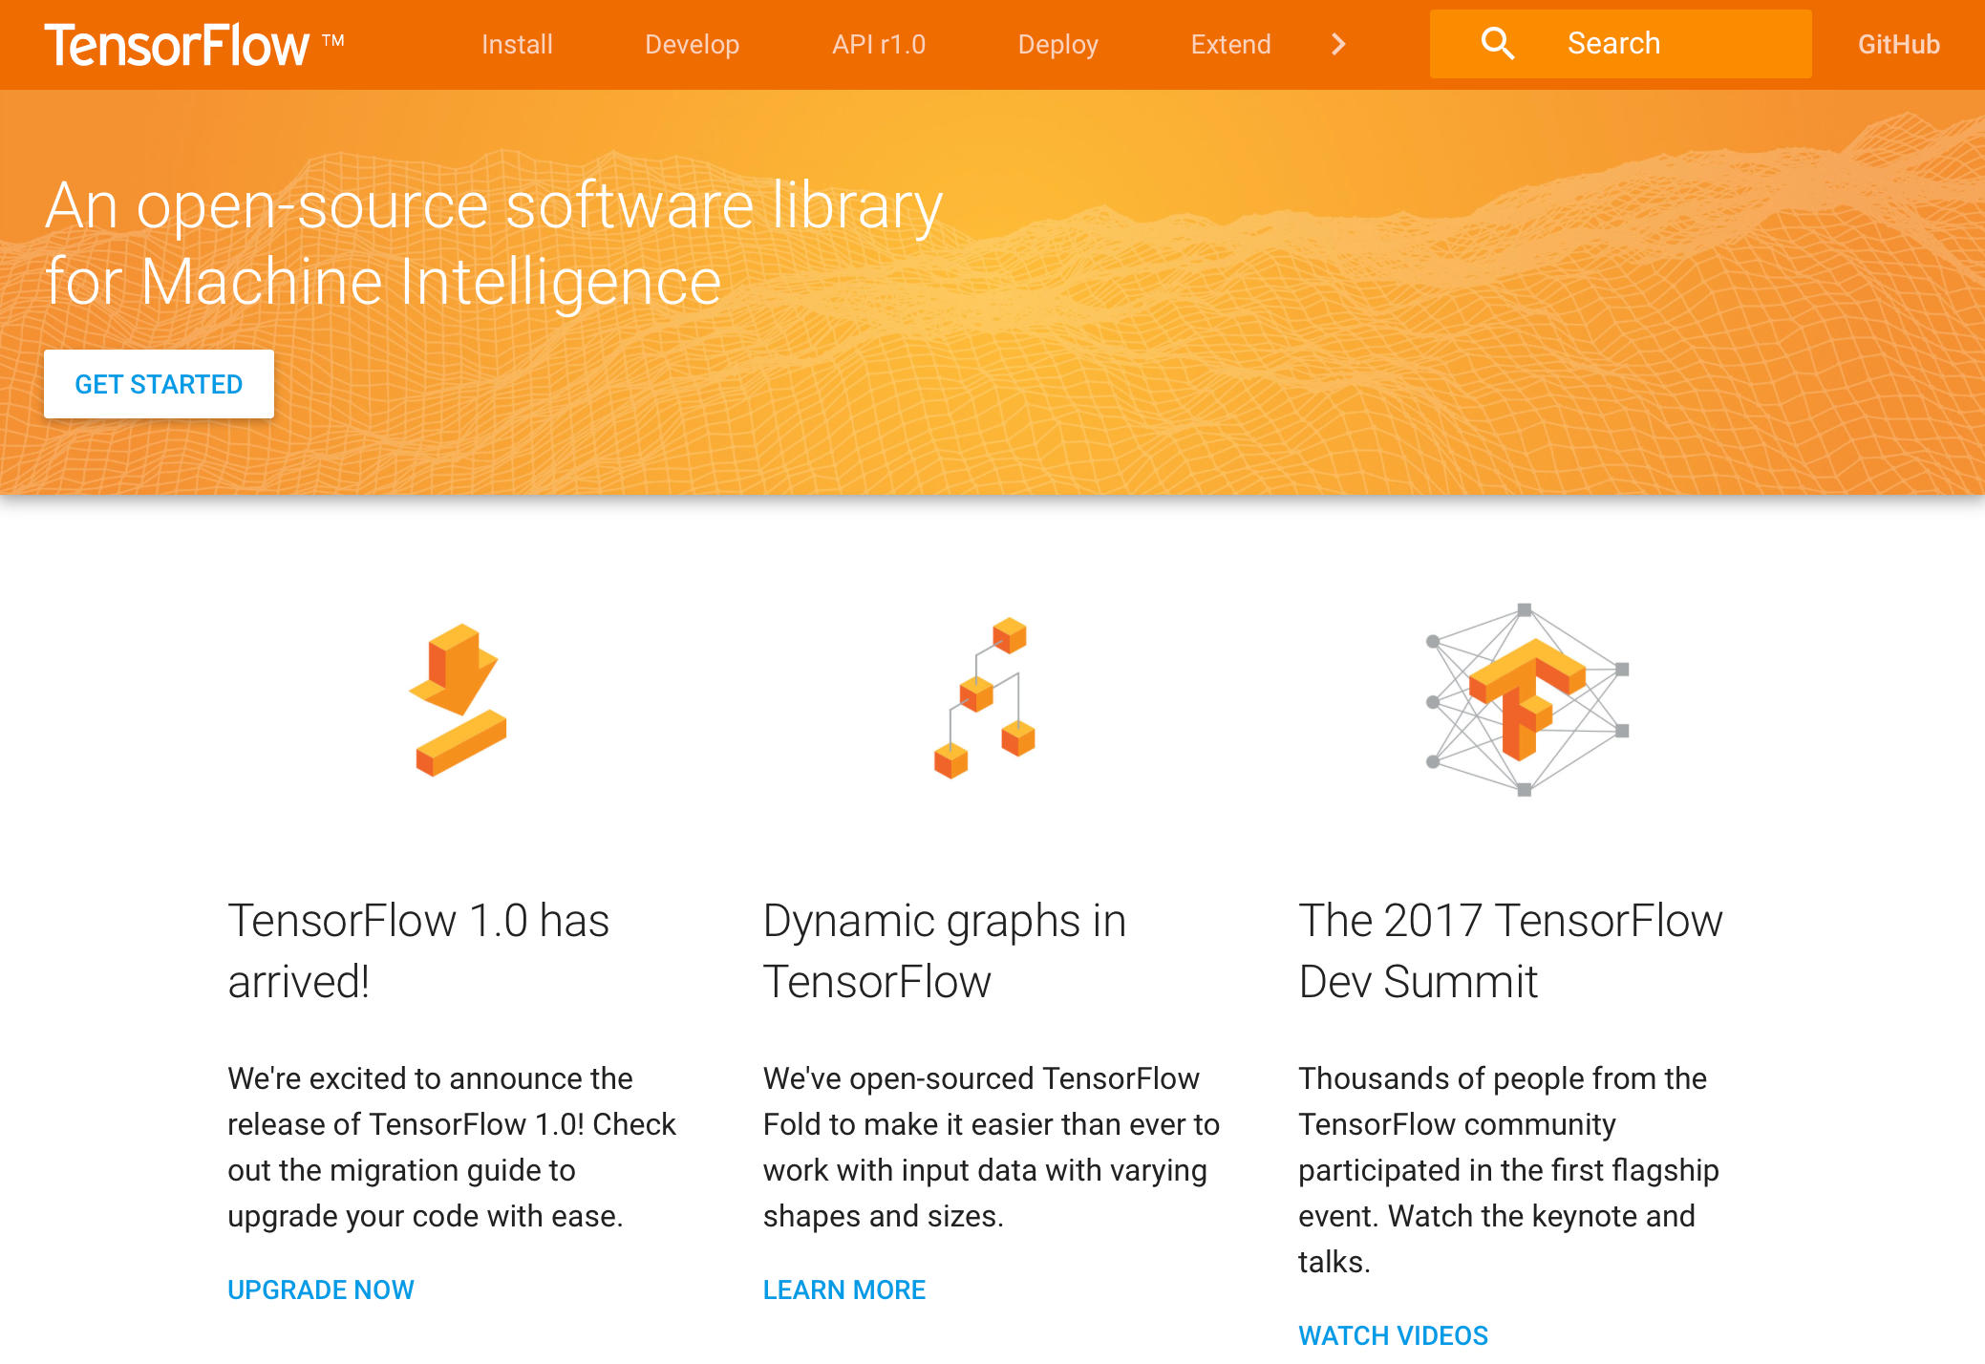
Tools and Books are freely available for building complex systems
http://chimera.labs.oreilly.com/books/1234000000754/index.html

Slide 8
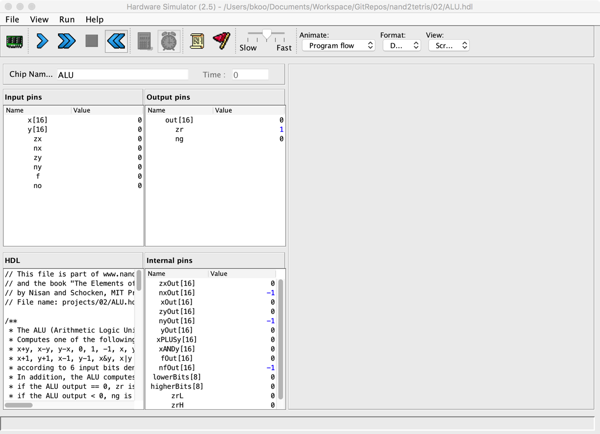
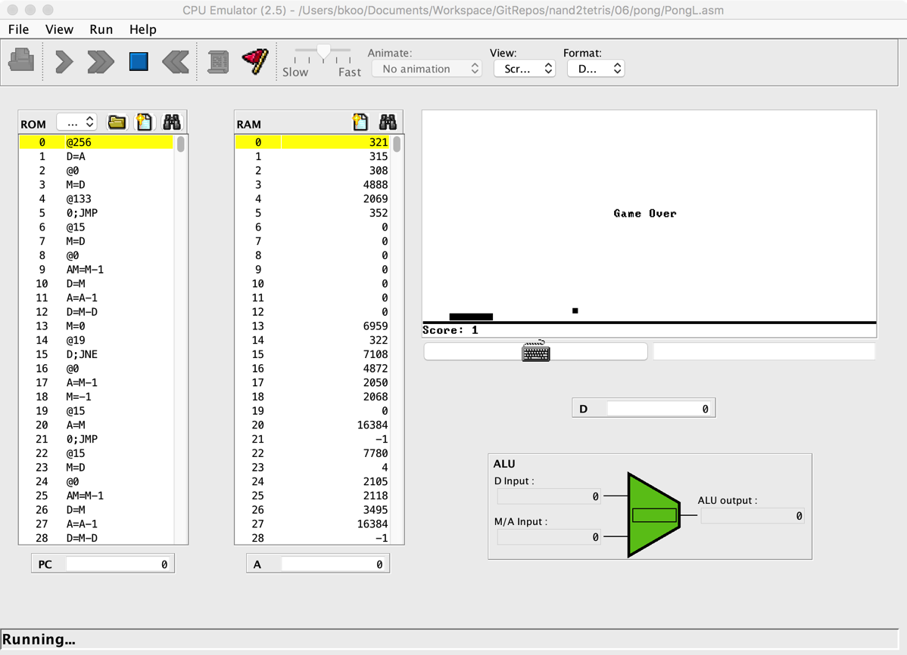
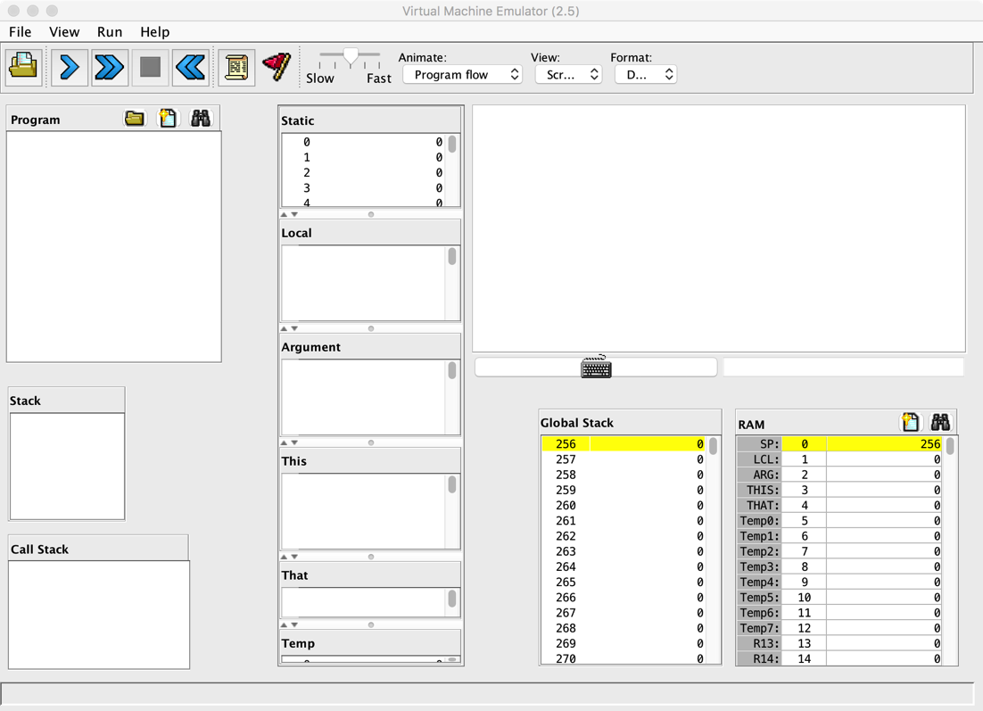
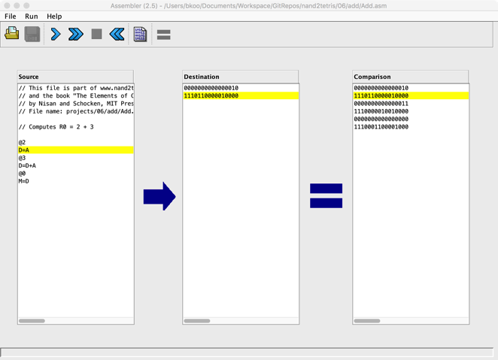
模块化项目 + 自动检验工具

Slide 9
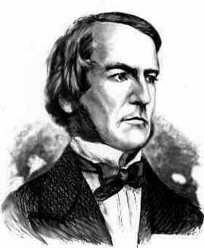
Boolean algebra
Given: Nand(a,b), false
We can build:
Not(a) = Nand(a,a)
true = Not(false)
And(a,b) = Not(Nand(a,b))
Or(a,b) = Not(And(Not(a),Not(b)))
Xor(a,b) = Or(And(a,Not(b)),And(Not(a),b)))
Etc.
George Boole, 1815-1864
(“A Calculus of Logic”)

Slide 10
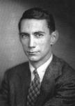
Gate logic
Interface
Claude Shannon, 1916-2001
(“Symbolic Analysis of Relay and Switching Circuits” )
Implementation
Xor(a,b) = Or(And(a,Not(b)),And(Not(a),b)))

Slide 11
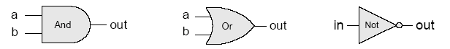
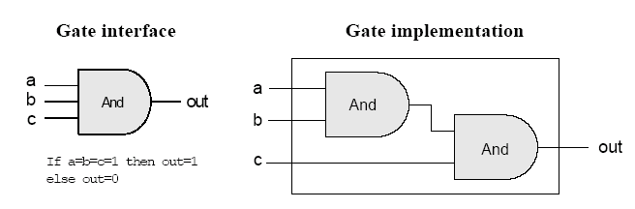
Gate logic
Gate logic – a gate architecture designed to implement a Boolean function
Elementary gates:
Composite gates:
Important distinction: Interface (what) VS implementation (how).

Slide 12
Multiplexer
a b sel out
0 0 0 0
0 0 1 0
0 1 0 0
0 1 1 1
1 0 0 1
1 0 1 0
1 1 0 1
1 1 1
sel out
0 a
1 b
Proposed Implementation: based on Not, And, Or gates.

Slide 13
Example: Building an And gate
Contract:
When running your .hdl on our .tst, your .out should be the same as our .cmp.
And.cmp
a b out
0 0 0
0 1 0
1 0 0
1 1 1
And.hdl
And.tst
CHIP And
{ IN a, b;
OUT out;
// implementation missing
}
load And.hdl,
output-file And.out,
compare-to And.cmp,
output-list a b out;
set a 0,set b 0,eval,output;
set a 0,set b 1,eval,output;
set a 1,set b 0,eval,output;
set a 1, set b 1, eval, output;

Slide 14
Building an And gate
Interface: And(a,b) = 1 exactly when a=b=1
And.hdl
CHIP And
{ IN a, b;
OUT out;
// implementation missing
}

Slide 15

Building an And gate
Implementation: And(a,b) = Not(Nand(a,b))
And.hdl
CHIP And
{ IN a, b;
OUT out;
// implementation missing
}

Slide 16
Building an And gate
Implementation: And(a,b) = Not(Nand(a,b))
And.hdl
CHIP And
{ IN a, b;
OUT out;
// implementation missing
}

Slide 17
Building an And gate
Implementation: And(a,b) = Not(Nand(a,b))
And.hdl
CHIP And
{ IN a, b;
OUT out;
Nand(a = a, b = b, out = x);
Not(in = x, out = out)
}

Slide 18
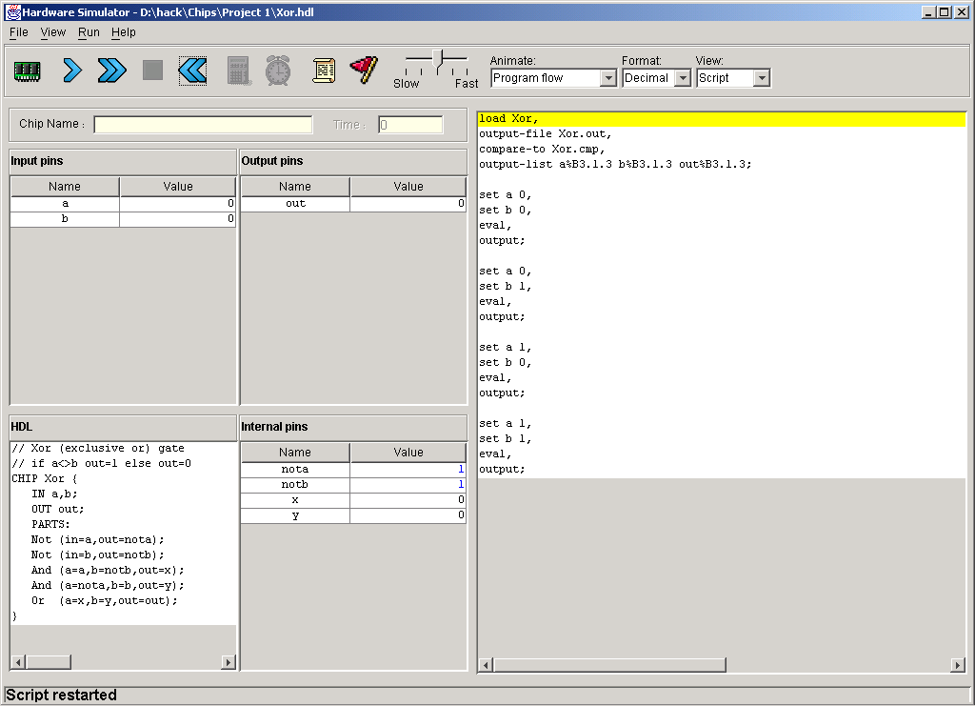
Hardware simulator (demonstrating Xor gate construction)
HDL program
test script

Slide 19
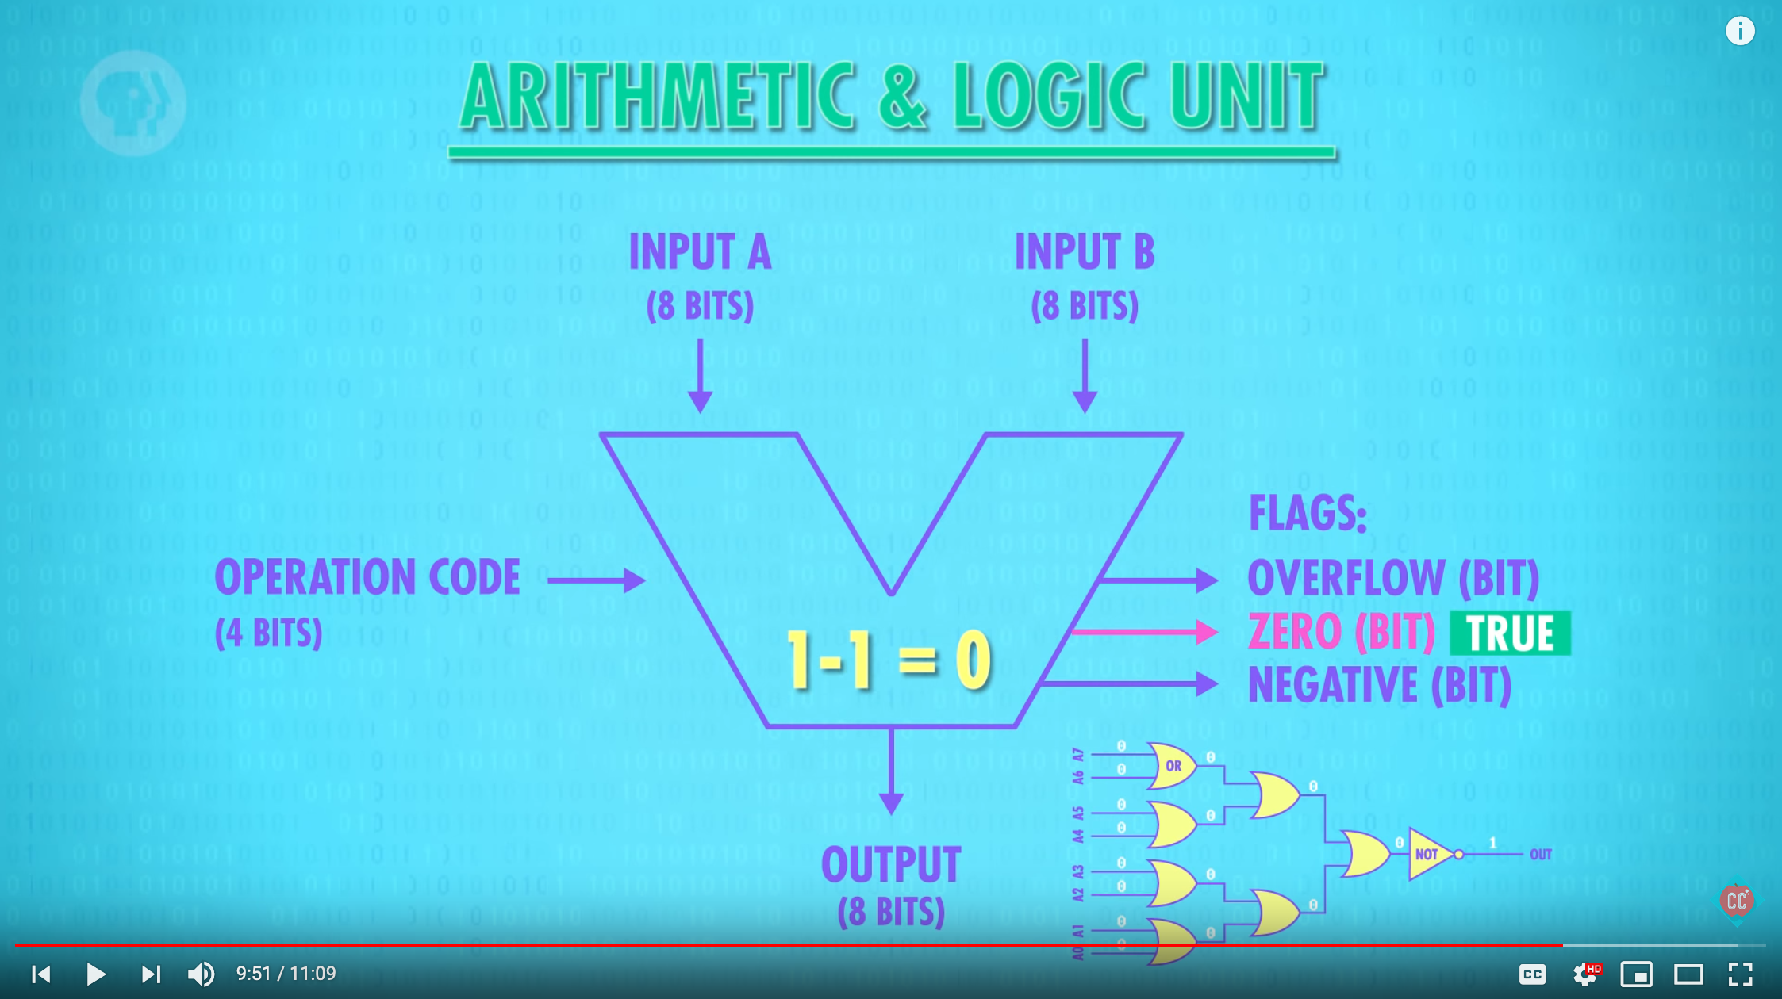
PBS Series: Crash Course on Computer Science
https://youtu.be/1I5ZMmrOfnA

Slide 20
Counting systems
quantity decimal binary 3-bit register
0 0 000
 1 1 001
 2 10 010
 3 11 011
 4 100 100
 5 101 101
 6 110 110
 7 111 111
 8 1000 overflow
 9 1001 overflow
 10 1010 overflow

Slide 21
Rationale

Slide 22
Binary addition
Assuming a 4-bit system:
0 0 0 1
1 0 0 1
0 1 0 1
0 1 1 1 0
1 1 1 1
1 0 1 1
0 1 1 1
1 0 0 1 0
+
+
no overflow
overflow
Algorithm: exactly the same as in decimal addition
Overflow (MSB carry) has to be dealt with.

Slide 23
Representing negative numbers (4-bit system)
0 0000
1 0001 1111 -1
2 0010 1110 -2
3 0011 1101 -3
4 0100 1100 -4
5 0101 1011 -5
6 0110 1010 -6
7 0111 1001 -7
1000 -8
The codes of all positive numbers begin with a “0”
The codes of all negative numbers begin with a “1“
To convert a number: leave all trailing 0’s and first 1 intact, and flip all the remaining bits
Example: 2 - 5 = 2 + (-5) = 0 0 1 0
+ 1 0 1 1
1 1 0 1 = -3

Slide 24
Building an Adder chip
Adder: a chip designed to add two integers
Proposed implementation:
Half adder: designed to add 2 bits
Full adder: designed to add 3 bits
Adder: designed to add two n-bit numbers.

Slide 25
Half adder (designed to add 2 bits)
a b sum carry
0 0 0 0
0 1 1 0
1 0 1 0
1 1 0 1
Implementation: based on two gates that you’ve seen before.

Slide 26
Full adder (designed to add 3 bits)
a b c sum carry
0 0 0 0 0
0 0 1 1 0
0 1 0 1 0
0 1 1 0 1
1 0 0 1 0
1 0 1 0 1
1 1 0 0 1
1 1 1 1 1
Implementation: can be based on half-adder gates.

Slide 27
n-bit Adder (designed to add two 16-bit numbers)
+
... 1 0 1 1 a
… 0 0 1 0 b
… 1 1 0 1 out
Implementation: array of full-adder gates.

Slide 28
The ALU (of the Hack platform)
out(x, y, control bits) =
x+y, x-y, y–x,
0, 1, -1,
x, y, -x, -y,
x!, y!,
x+1, y+1, x-1, y-1,
x&y, x|y

Slide 29
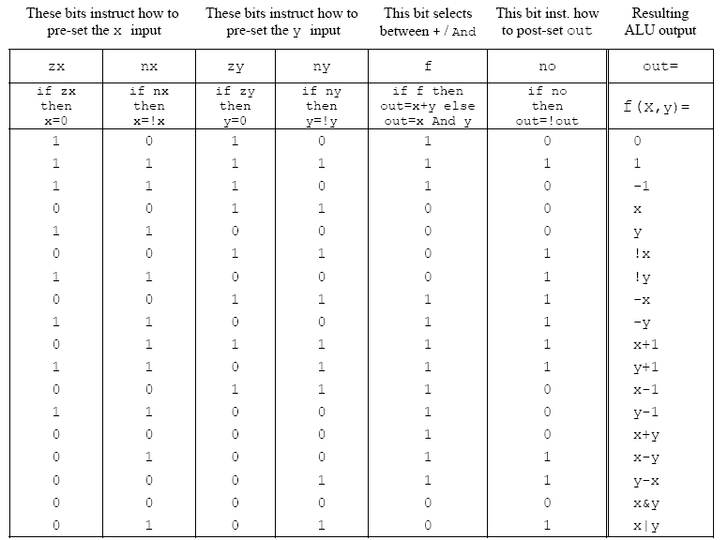
ALU logic (Hack platform)
Implementation: build a logic gate architecture that “executes” the control bit “instructions”: if zx==1 then set x to 0 (bit-wise), etc.

Slide 30
The ALU in the CPU context (a sneak preview of the Hack platform)
c1,c2, … ,c6
D
D register
a
out
A
ALU
A register
A/M
Mux
RAM
(selected register)
M

Slide 31
Perspective
Combinational logic
Our adder design is very basic: no parallelism
It pays to optimize adders
Our ALU is also very basic: no multiplication, no division
Where is the seat of more advanced math operations? a typical hardware/software tradeoff.

Slide 32
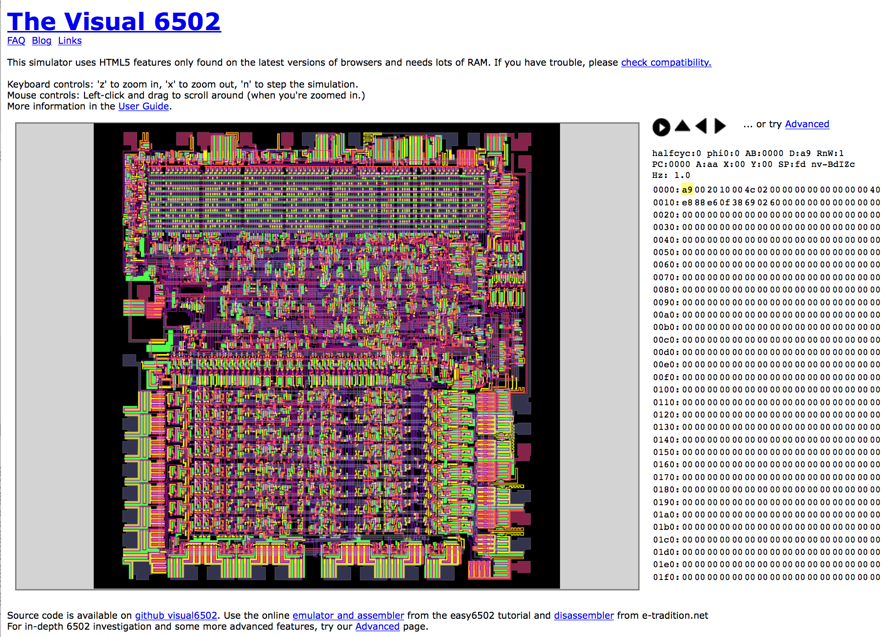
CPU 是一种图灵完备的计算单元
https://en.wikipedia.org/wiki/MOS_Technology_6502
http://www.visual6502.org/JSSim/index.html

Slide 33
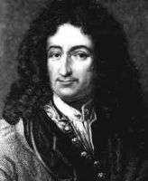
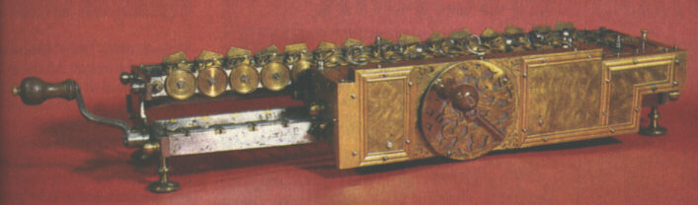
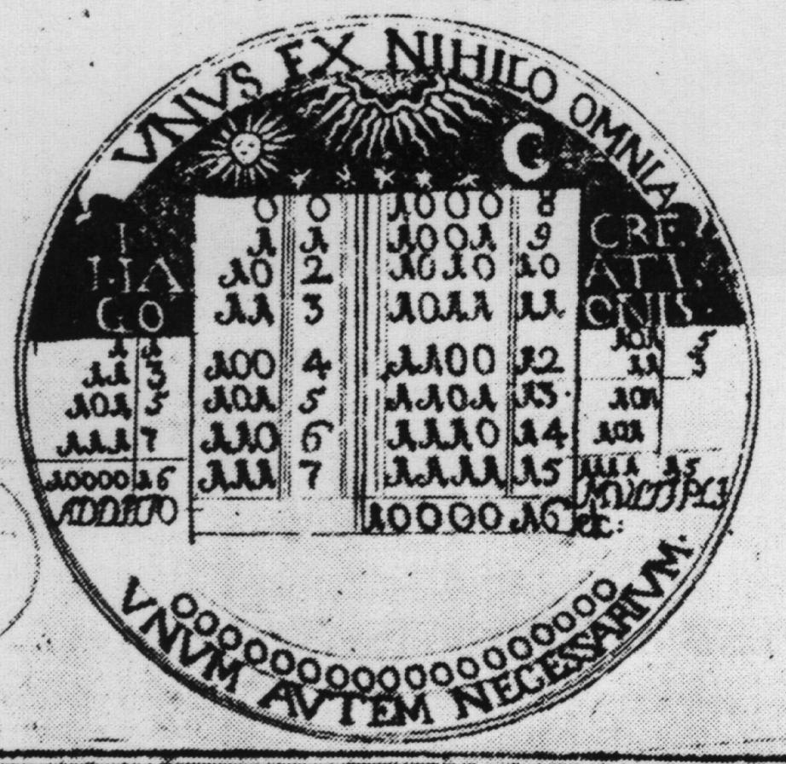
Historical end-note: Leibnitz (1646-1716)
“The binary system may be used in place of the decimal system; express all numbers by unity and by nothing”
1679: built a mechanical calculator (+, -, *, /)
CHALLENGE: “All who are occupied with the reading or writing of scientific literature have assuredly very often felt the want of a common scientific language, and regretted the great loss of time and trouble caused by the multiplicity of languages employed in scientific literature:
SOLUTION: “Characteristica Universalis”: a universal, formal, and decidable language of reasoning
The dream’s end: Turing and Gödel in 1930’s.
Leibniz’s medallion for the Duke of Brunswick

Slide 34
Gödel Numbering
Kurt Gödel’s picture from Wikipedia
In mathematical logic, a Gödel numbering is a function that assigns to each symbol and well-formed formula of some formal language a unique natural number, called its Gödel number. The concept was used by Kurt Gödel for the proof of his incompleteness theorems. (Gödel 1931)
https://en.wikipedia.org/wiki/G%C3%B6del_numbering#CITEREFG.C3.B6del1931

Slide 35
Cellular Automata
John Horton Conway
Picture from Wikipedia
Cellular Automaton picture from Wikipedia
A cellular automaton (pl. cellular automata, abbrev. CA) is a discrete model studied in computability theory, mathematics, physics, complexity science, theoretical biology and microstructure modeling. Cellular automata are also called cellular spaces, tessellation automata, homogeneous structures, cellular structures, tessellation structures, and iterative arrays.
https://en.wikipedia.org/wiki/Cellular_automaton

Slide 36
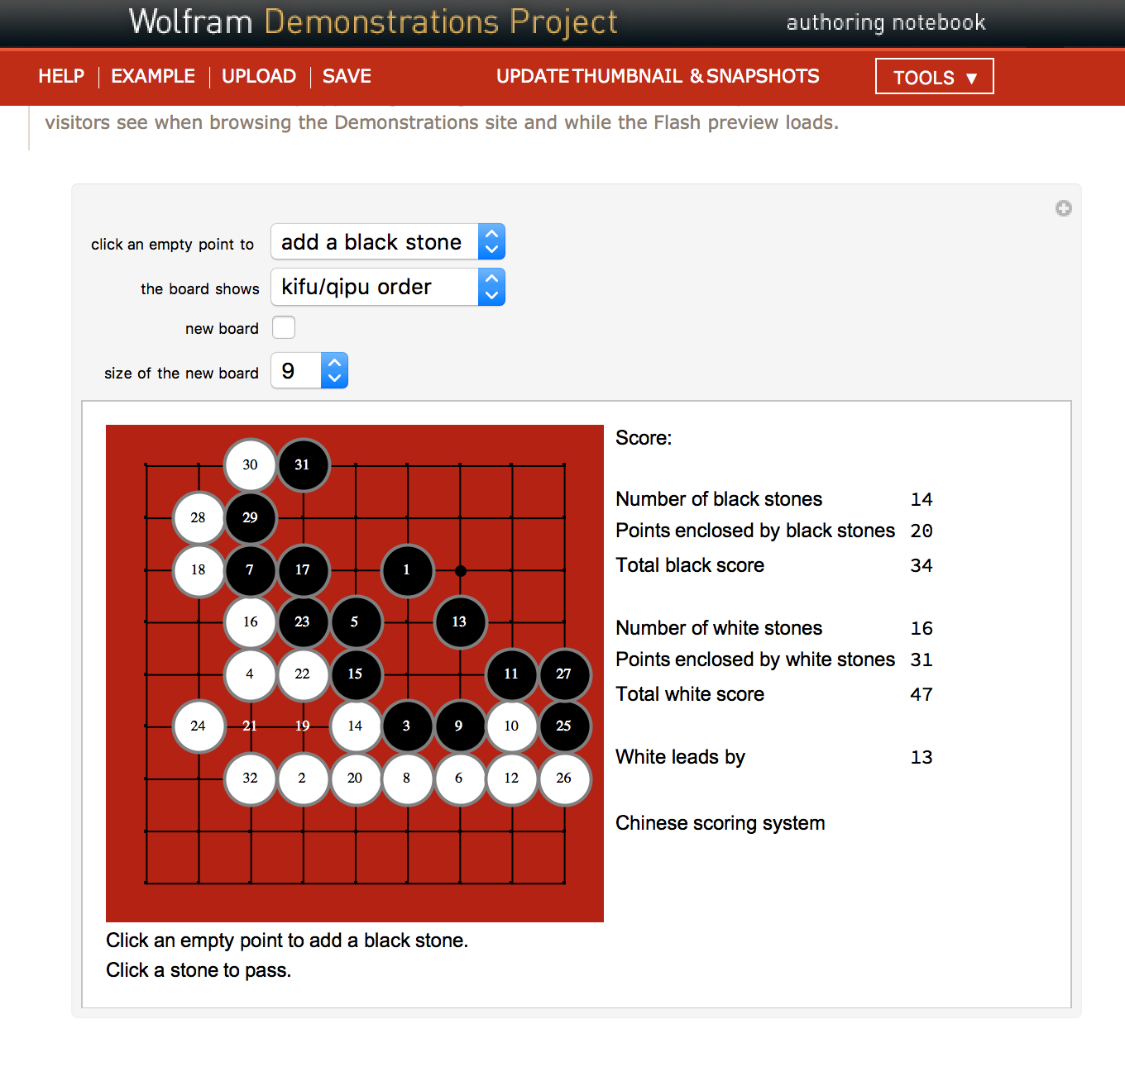
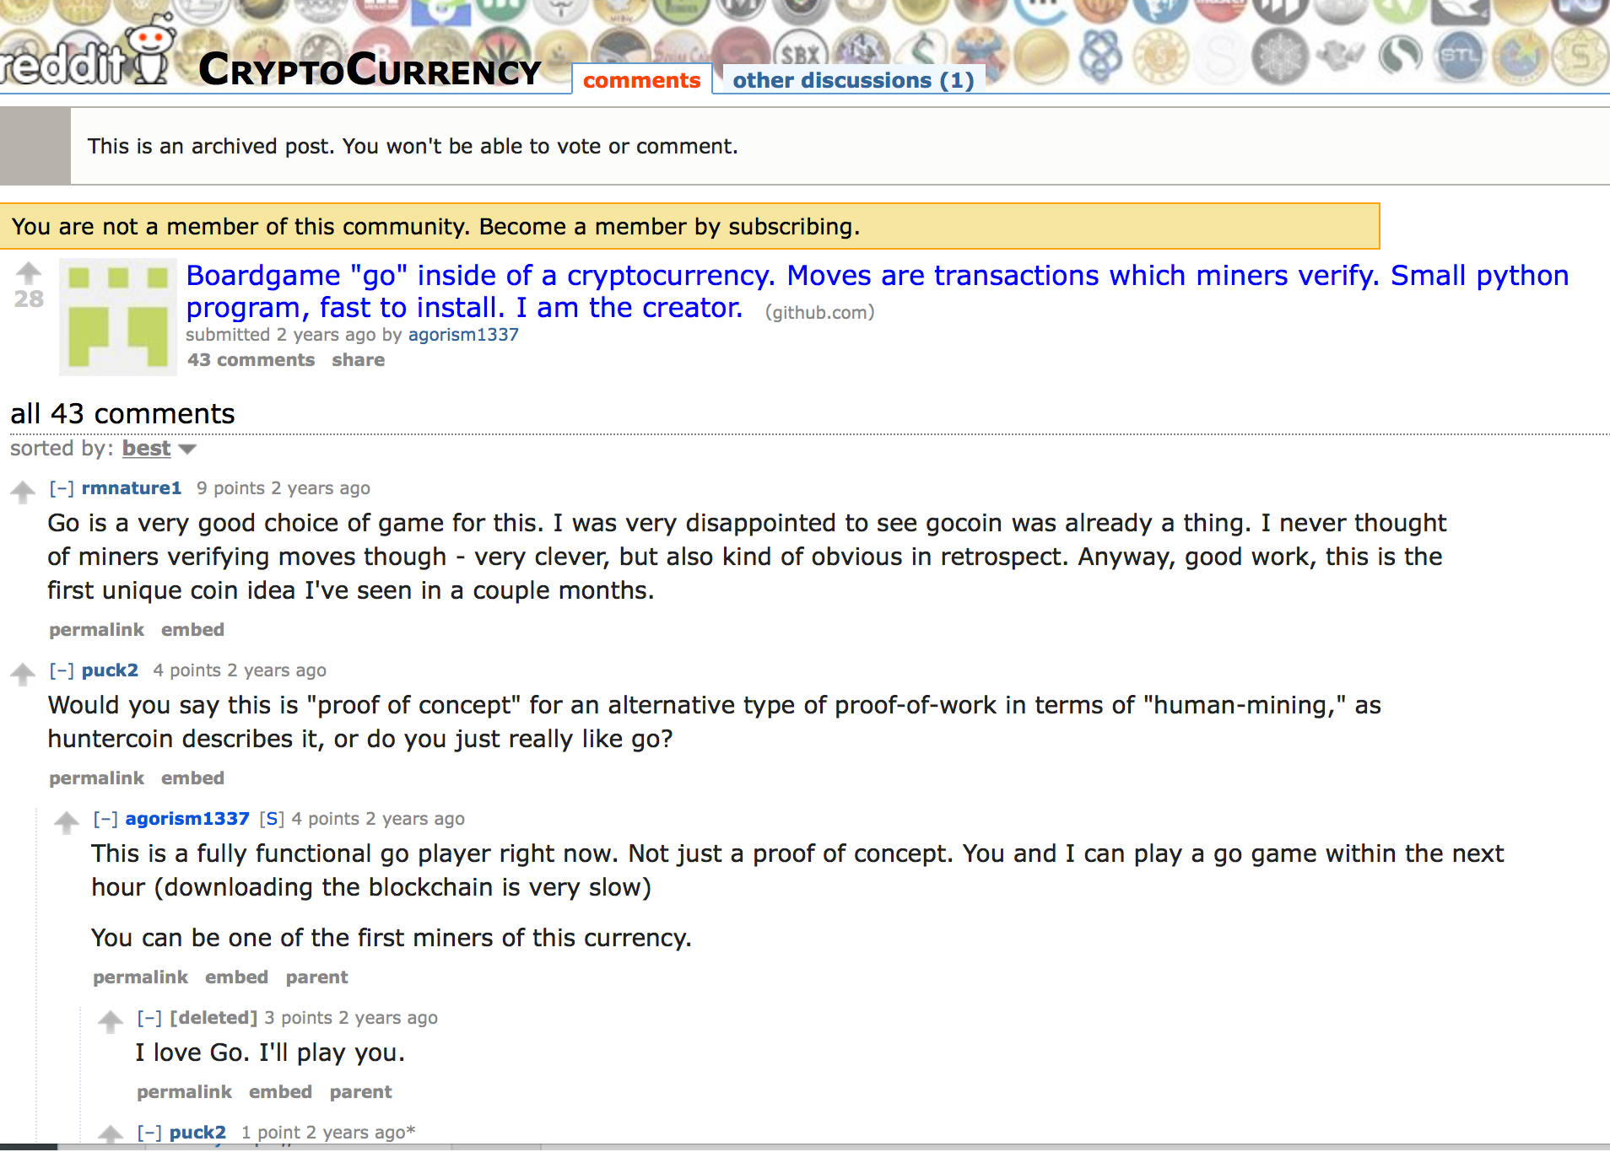
Application level: Go (by: José Luis Gómez-Muñoz)

Slide 37
课程分数的评价
Your ability in identifying proper reference material
Learn from the Internet and Public Libraries
Use relevant data sources and provide argument for its validity
Your interpretation of content
Reflected in your documentation and implementation of the Go System
Grade Distribution
20% 课上参与， 40% 软件作业， 20% 学习报告，20% 教科书。

